Slide 1
Choices for Youth
Avery Bass, Mark Labiano, Matt Corbitt, Pierre Kaseen, & Haojie Chen

Slide 2
Bright Minds To inspire young minds to innovate, not regurgitate
Education Department

Slide 3
Department Overview
Primarily for students who are struggling in school to grasp certain subjects.
Focus on Math, Science and English.
Our goal is to help students grasp certain subjects or topics in school that they may not be comfortable with.

Slide 4
5-Stages
Pre-contemplation: Student’s are failing subjects because lack of inspiration and help
Contemplation: The youth need help and inspiration to learn.
Preparation: We started looking into resources we would need to be able to help the youth.
Books, Teachers, Specific programs
Action: We opened up this department with after school hours for students.
Maintenance: Students come as often as needed to get tutoring. Special programs set

Slide 5
S.M.A.R.T
Focus on educational needs
Measured based on individual needs
Specific vs. overall
Achievable through dedication and self-confidence
Rewarded through improved grades and better understanding
The time it takes is up to the student.
Each day after school, once a week, once a month, etc.

Slide 6
Department Overview Cont’d
Challenges
Students wanting help
Having enough teachers
Resources
Books: Students get new books depending on the program.
Many free books are available for students also
Teachers: There are teachers with specific knowledge to help students
Supplemental course work and outlines
Reward
Students will be inspired to learn; not only for their benefit, but for their community.

Slide 7
When in Doubt, Talk It Out
A youth violence prevention program.

Slide 8
Causes of Youth Violence (according to the CDC)
Parenting issues (incl. authoritarian child raising, harsh, lax or inconsistent discipline, etc.)
Involvement in gangs
Poor academic performance
High levels of transiency or family disruption
Socially disorganized neighborhoods
Diminished economic opportunities

Slide 9
Department Mission
To reduce or eliminate instances of youth-on-youth or youth-on-other violence
Use a variety of programs in place to help youth cope with issues, but mainly focus on the anger aspect that stems from the stressful situations.

Slide 10
5 Stages of Anti-Violence Change
Precontemplation: Youth are quick to anger because of hormonal activities and lack of wisdom that comes with age, and the condition is worsened by stressful situations that they may not know how to cope with.
Contemplation: Youth need help coping with stress and learning ways to resolve issues without violence.
Preparation: We started looking into the types of issues most youth face that causes them distress, and trying to find ways to help them.
Youth church groups, support groups, or , if the issue is academic in nature, a referral to our academic department for tutoring services.
Action: We started this program with support groups and religious groups after school hours to help our students with a variety of issues. All youth of the community are welcome to the program. We have also set up a special late-hours hotline number that can be called in an emergency for special counseling.
Maintenance: The youth of the community may come as often as needed.

Slide 11
S.M.A.R.T.
Focus on emotional and mental needs
Recommendation of programs based off of specific emotional needs
Achievable through persistence and determination to better the community and reduce violence
Rewarded through better quality of life within the community, as well as increased life-expectancy and physical and emotional wellness
The time allotted is decided by the individual child

Slide 12
Department Overview
Challenges
Youth wanting to help control their anger
Having enough counselors
Resources
Counselors and religious leaders
A space to use for the counseling sessions
Reward
Betterment of the community
Lengthening and improving the child’s quality of life

Slide 13
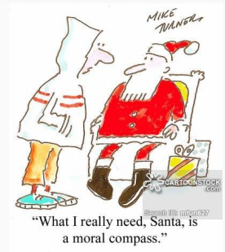
Youth Social Problems
Anxiety
Bullying
Society
Poverty
“Fitting In”

Slide 14
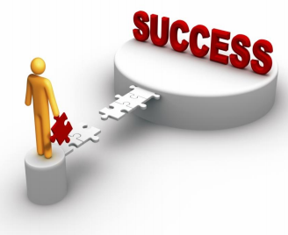
Choices For Youth
Open to ages 10-17
“We Aim For Success And Nothing Less”
Department Hours 12pm-9pm
2 Counselor & 1 Psychologist

Slide 15
Lights, Camera, ACTION!!!!!!
Mission Statement:
Choices For Youth is dedicated to developing children and young adults with the sense of understanding and awareness for others, enduring creative and efficient minds, and giving them firmness of their choices. Thus, we respect each individual choice of change: spiritual, moral, intellectual, social, emotional, and physical.

Slide 16
5 Stages
Pre contemplation: they are uncertain of who they are and what they want in society and will need advice from elders.
Contemplation: The youth will need help and communicating and solving problems with being more social and expressive, rather than anti- social and depress
Preparation: Includes Youth activities , support groups, or , if the issue is out of the departments control we will other departments do what they can to help.
Action: The support of all staff from “Choices For Youth and loved ones.
Maintenance: We will have daily, weekly, and monthly meetings and reminders of motivation for our students.

Slide 17
SMART
Specific: The goal is to help the youth make better choices facing the reality of life’s obstacles by giving them the experience in social activities, weekly private meetings, and organizing a group activity.
Measurable: We are always aiming for a increase in our students success patterns in life.
Achievable: In order to achieve our goals efficiently we are providing the students with a 24/7 support hotline.
Reward: We offer the students weekly prizes of gift cards, trips, event tickets, or anything they are interested in. However, rewards are giving if the staff see production and determination from the students.
Time: Success in our students varies from 6 months until the age of 18(depending on the age and progress of the individual).

Slide 18

Physical Health
Department overview
Challenge:
The need to understand what physical health is
Resource:
Family support of staff and people
Reward:
Increases chance of living longer
Improve upon mood mental health

Slide 19
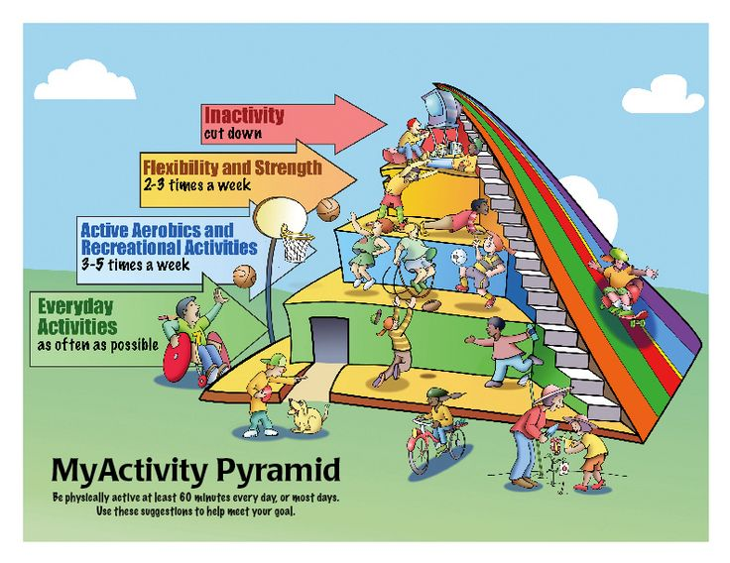
Department Mission
To lower obesity
Maintain healthy physics
Live longer

Slide 20
S.M.A.R.T
Specific: smart choices in life and food
Measureable: by keeping up their daily routine and individual needs
Achievable: by the determination of keeping a healthy and prosperous life
Reward: strengthen bones and reduce the risk of cancer
Time: improvement body complexity
From past achievement to present achievement

Slide 21
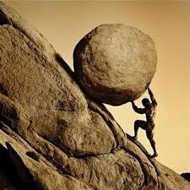
5- Stages
Precontemplation: they are unaware of their surrounding and them self and might need an extra push to move forward
Contemplation: in the state of lost in mind as in if they are doubting their own self about their next action
Preparation: beginnings are always the hardest to the next action
Action: by supporting them through the finish line
Maintenance: scheduled list of actions

